Slide 1
2D Composite Transformation
Computer Graphics
Shahnaj Parvin
Lecturer

Slide 2
2D Composite Transformation
A number of transformations or sequence of transformations can be combined into single one called as composition.
The resulting matrix is called as composite matrix. The process of combining is called as concatenation.

Slide 3
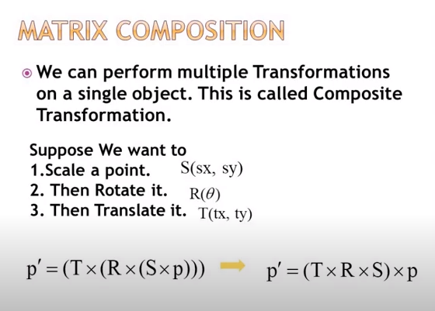
2D Composite Transformation

Slide 4
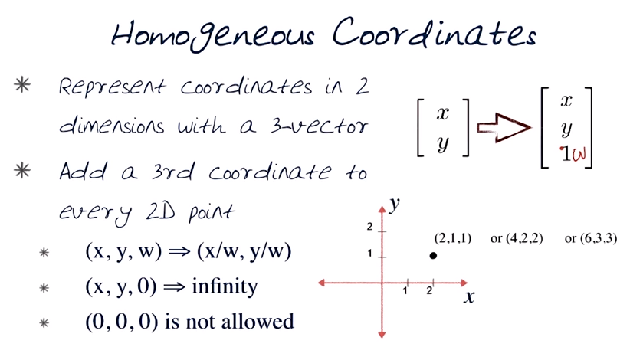
2D Composite Transformation

Slide 5
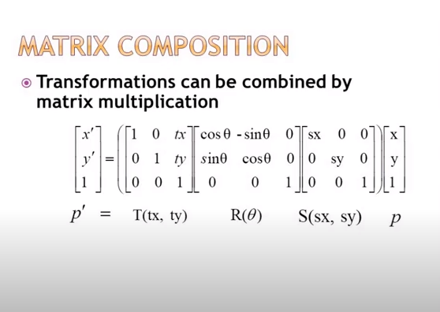
2D Composite Transformation

Slide 6
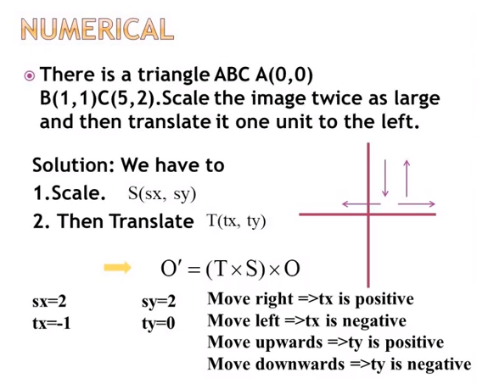
2D Composite Transformation

Slide 7
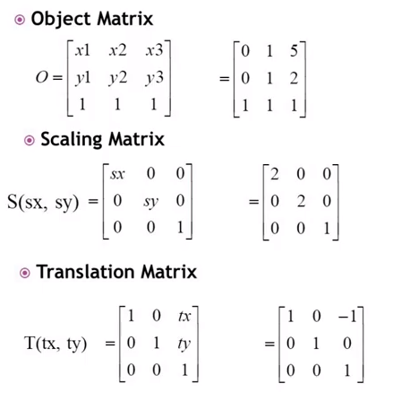
2D Composite Transformation

Slide 8
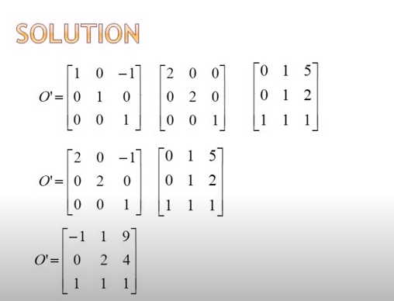
2D Composite Transformation

Slide 9
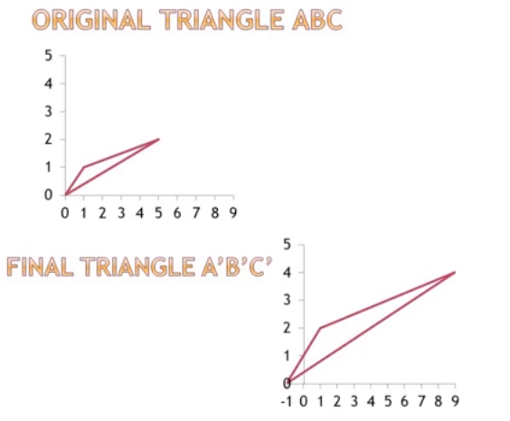
2D Composite Transformation

Slide 10
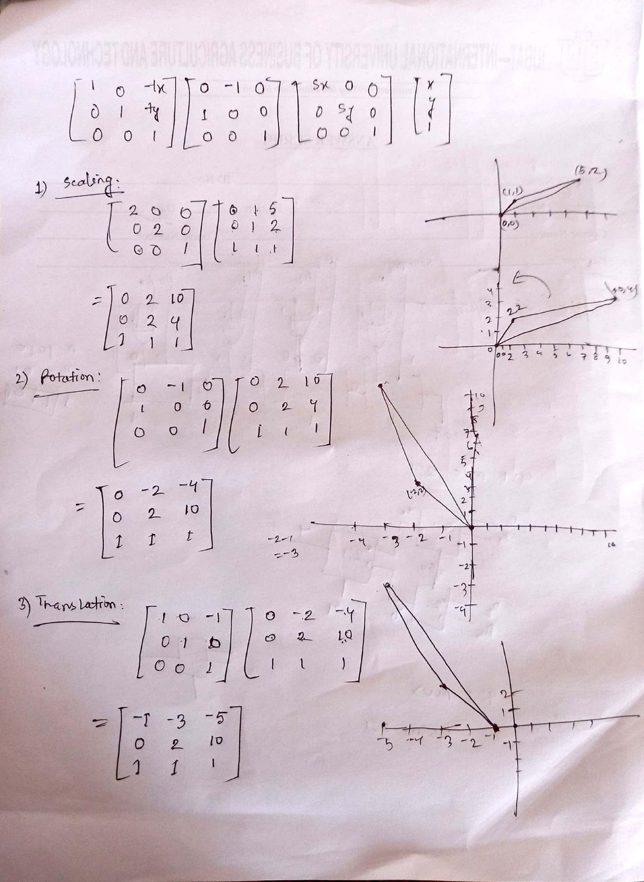
2D Composite Transformation

Slide 11
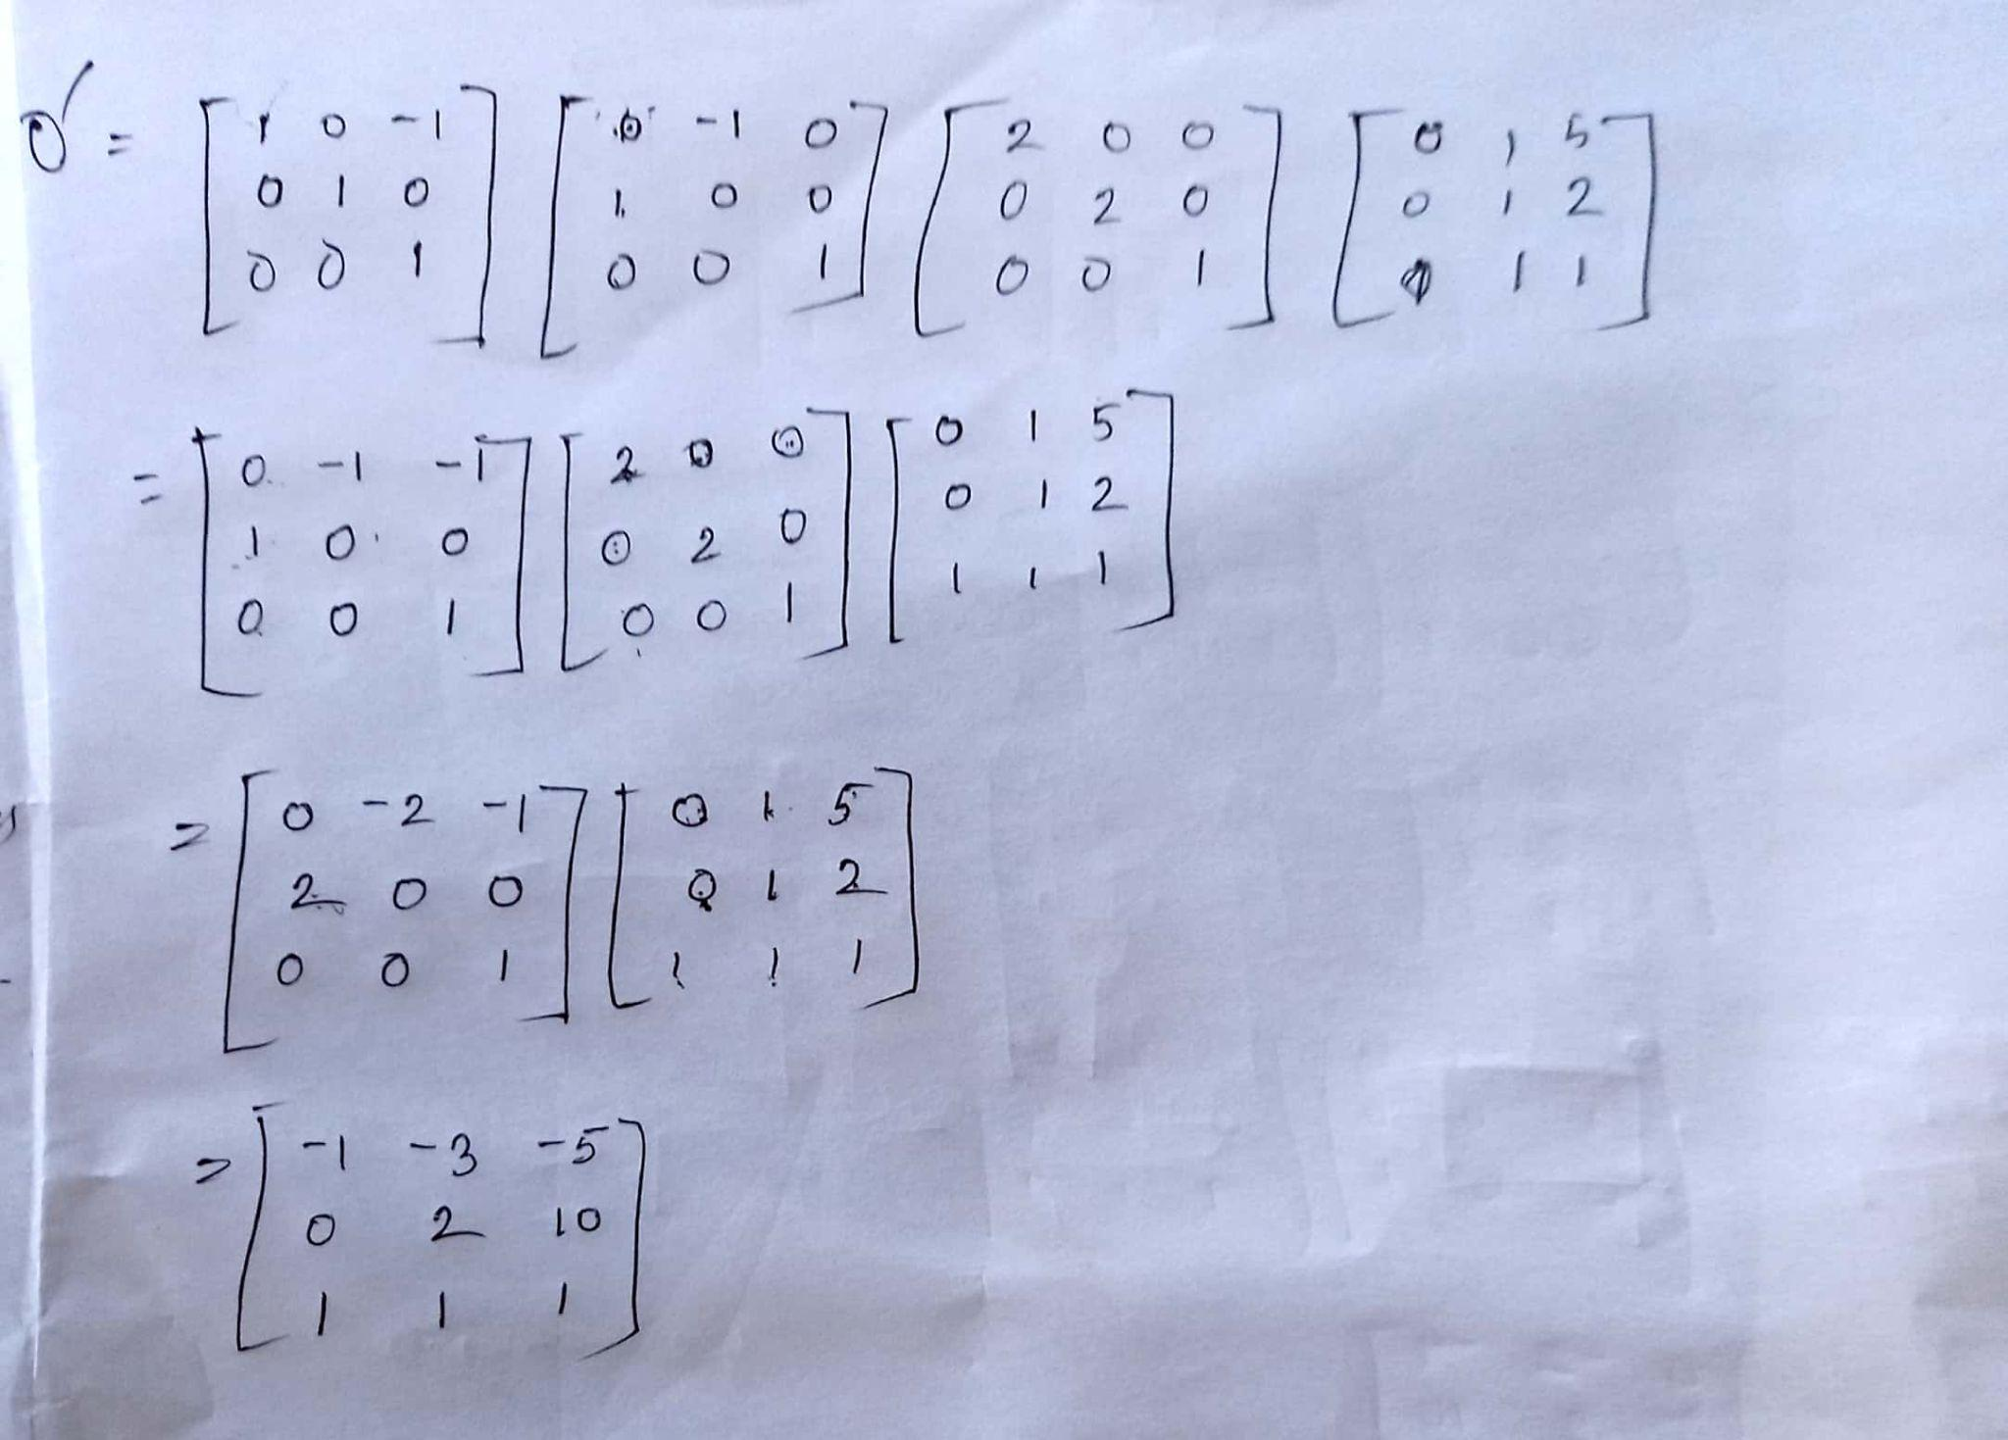
2D Composite Transformation

Slide 12
2D Composite Transformation Practice
Problem 01:
Consider we have a square O(0, 0), B(4, 0), C(4, 4), D(0, 4) on which we first apply T1(scaling transformation) given scaling factor is Sx=Sy=0.5 and then we apply T2(rotation transformation in clockwise direction) it by 90⁰(angle), in last we perform T3(reflection transformation about origin).

Slide 13
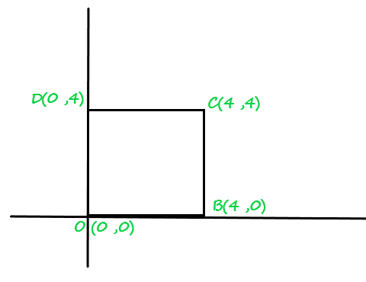
2D Composite Transformation Practice
Problem 01:
Solution:
The square O, A, C, D looks like :

Slide 14
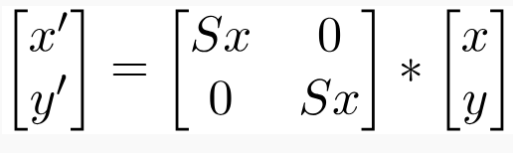
2D Composite Transformation Practice
Problem 01:
First, we perform scaling transformation over a 2-D object :
Representation of scaling condition :

Slide 15
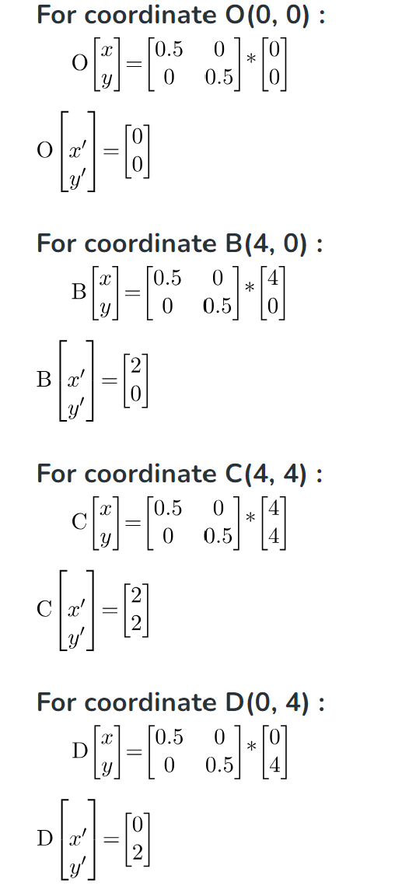
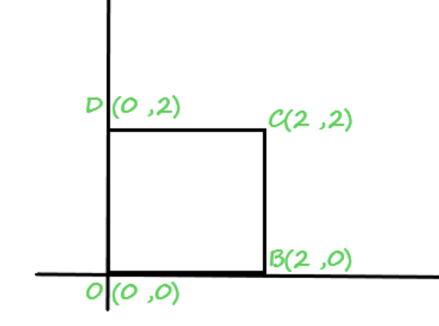
2D Composite Transformation Practice
Problem 01:
Fig 1
Fig 2

Slide 16
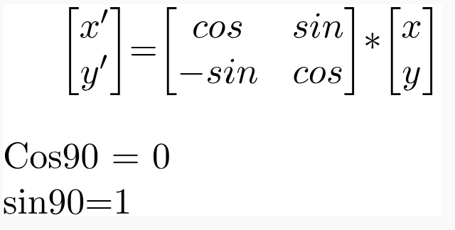
2D Composite Transformation Practice
Problem 01:
Now, we’ll perform rotation transformation in clockwise-direction on Fig.2 by 90^{θ}:
The condition of rotation transformation of 2D object about origin is :

Slide 17
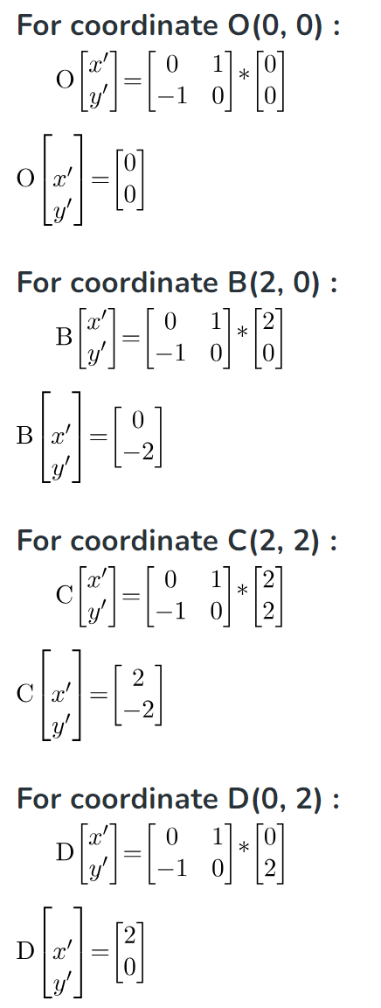
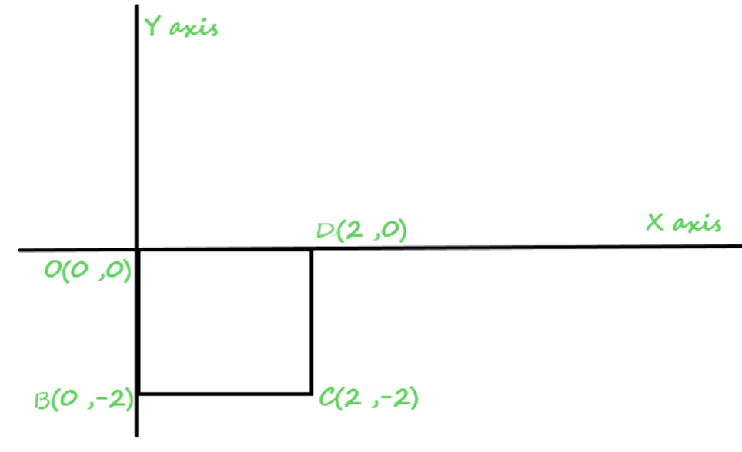
2D Composite Transformation Practice
Problem 01:
Fig 2
Fig 3

Slide 18
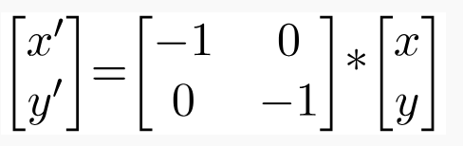
2D Composite Transformation Practice
Problem 01:
Now, we’ll perform third last operation on Fig.3, by reflecting it about origin :
The condition of reflecting an object about origin is

Slide 19
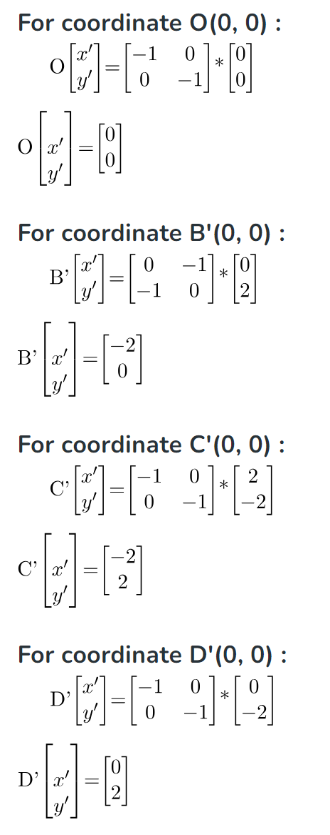
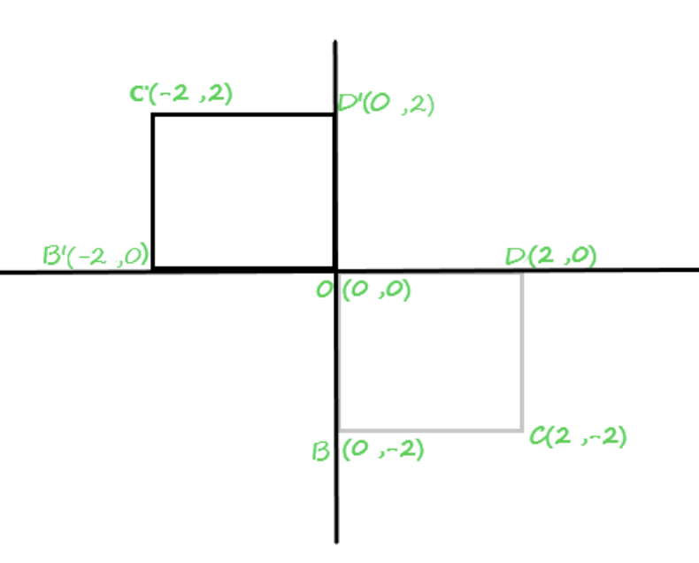
2D Composite Transformation Practice
Problem 01:
Fig 4
Fig 3

Slide 20
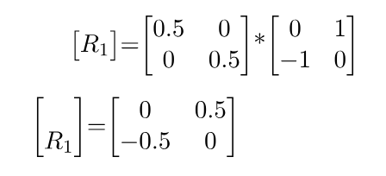
2D Composite Transformation Practice
Problem 01:
Solution using Composite transformation :
First we multiplied 2D matrix conditions of Scaling transformation with Rotation transformation :

Slide 21
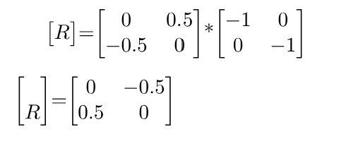
2D Composite Transformation Practice
Problem 01:
Now, we multiplied Resultant 2D matrix(R1) with the third last given Reflecting condition of transformation(R2) to get Resultant(R) :

Slide 22
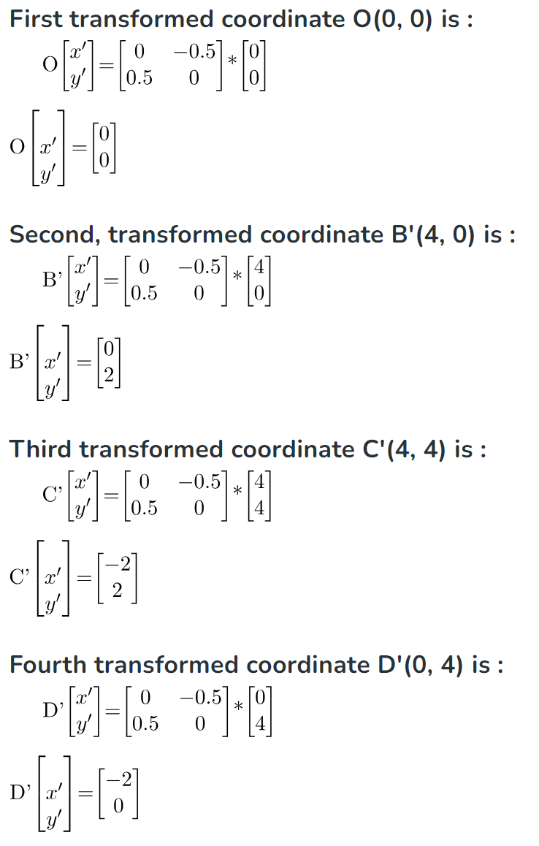
2D Composite Transformation Practice
Problem 01:
Now, we’ll applied the Resultant(R) of 2d-matrix at each coordinate of the given object (square) to get the final transformed or modified object.

Slide 23
2D Composite Transformation Practice
Problem 01:
Consider we have a square A(0, 3), B(4, 2), C(4, 5) on which we first apply T1(scaling transformation) given the scaling factor is Sx=2 Sy=1 and then we apply T2(rotation transformation in an anti-clockwise direction) it by 90⁰(angle), in last, we perform T3(translation two units left).

